Slide 1
Lecture 3/4

Slide 2
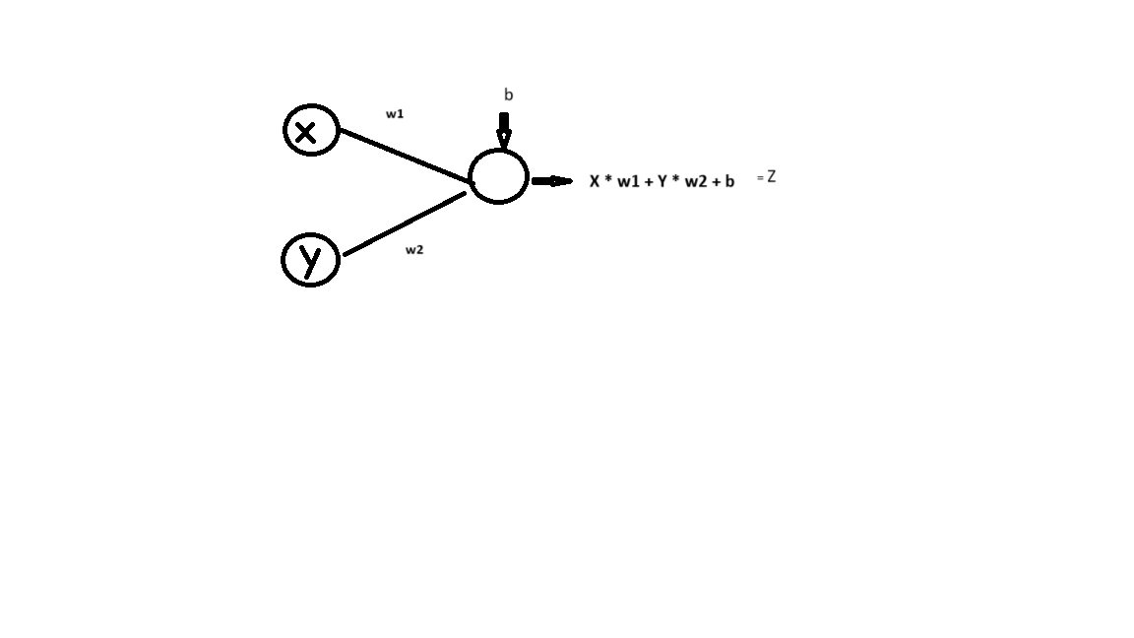
3.5.4 Model shape

Slide 3
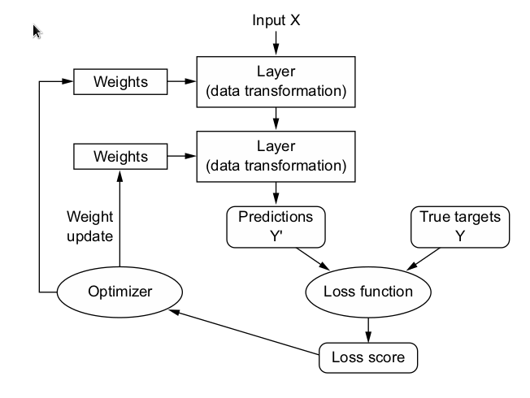
Last Lecture Key Points
Tensor, Tensor Ranks (ndim) link
Broadcasting Link
Layer (first, hidden[s], last) Leras.layers.Dense(512, activation="relu")
Forward Propagation (process) output = relu(dot(input, W) + b)
Tensor Operation (add, dot)
Predictions
Loss Function (y_pred-y_true)
Loss Score Loss Score)
Back Propagation
Optimizer (SGD, RMSProp, Adam)
Weights Update
Epoch

Slide 4
The engine of neural networks: Gradient-based optimization
TRAINING LOOP
Draw a batch of training samples, x, and corresponding targets, y_true.
Run the model on x (a step called the forward pass) to obtain predictions, y_pred.
Compute the loss of the model on the batch, a measure of the mismatch between (y_pred and y_true.)
Update all weights of the model in a way that slightly reduces the loss on this batch.

Slide 5
Gradient Descent
SGD (link)
Liner Fit Example (link)
Local vertical Concept (link)
Simulation - linear fit (link)

Slide 6
GPU Support
conda create --name tf python=3.9
conda activate tf
conda install -c conda-forge cudatoolkit=11.2 cudnn=8.1.0
pip install --upgrade pip
pip install "tensorflow-gpu<2.11"

Slide 7
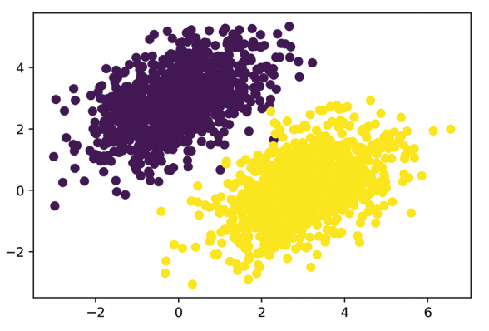
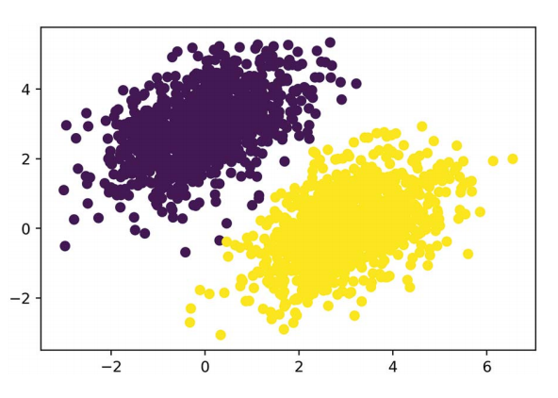
Original vs Model Predicted Data Example 3

Slide 8
3.6 Anatomy of a neural network: Understanding core Keras APIs
The fundamental data structure in neural networks is the layer,
A layer is a data processing module that takes as input one or more tensors and that outputs one or more tensors.
Some layers are stateless, but more frequently layers have a state
Different Types of Layers
Layer Type | Used for | Data Shape
DenseLayer | for Simple 2D data types | (sample,features)
Recurrent Layer (RNN/LSTM, 1DConv) | for Time Series / Sequence 3D data types | (sample, timestamp, features)
Conv2D | Image data | (sample, height, width)
Conv2D, PositionEncoding | Video Data | (sample, frame, height, width)

